Slide 1

Nuclear Charge Radii of Nickel Isotopes ${}_{}^{58−68,70}{Ni}$
Author:
S. Malbrunot-Ettenauer, S. Kaufmann, ...
时 间
Reporter: Xingcan Cao

Slide 2
CONTENTS
Motivation and Background
Theoretical Framework
Results and Analysis
Summary

Slide 3

1
Motivation and Background

Slide 4
Motivation
Nuclear charge radii are an important probe for nuclear structure.
- Accurate description of nuclear charge radii is a key benchmark for nuclear structure theory.
- Nickel (Z=28) is the last unexplored ‘magic’ isotopic chain in this mass region.
- Previous data existed only for 68Ni; this work extends to 59,63,65–67,70Ni. Phys. Rev. Lett. 124, 132502 (2020)
- Comparison with three ab initio methods and two density functional theory (DFT) approaches.
01

Slide 5
2
Theoretical Framework

Slide 6
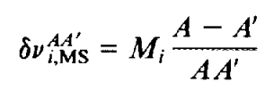
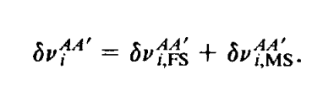
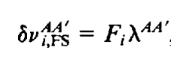
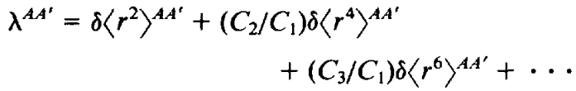
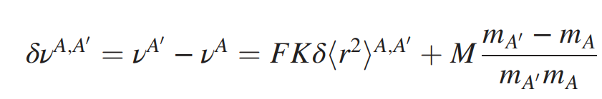
How to determine charge radius.
Outer atomic electrons may serve as a probe of the nuclear structure. The isotope shift of optical transitions has two case: field shift (FS) and mass shift (MS)
Keep in terms of the first order
use a King fit procedure to extract the mass and field-shift constants

Slide 7
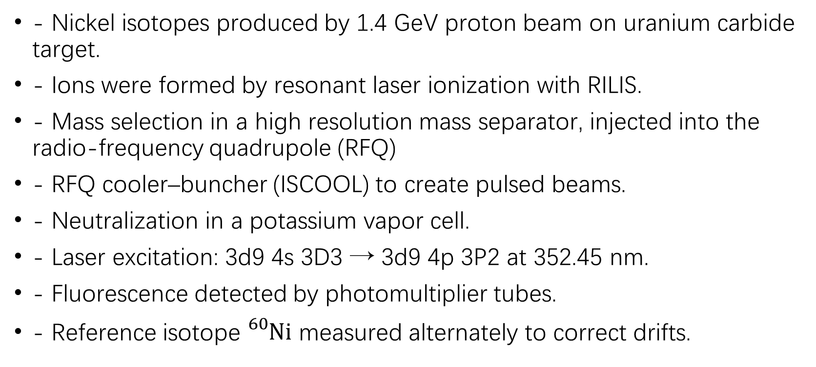
Experimental setup.
- Nickel isotopes produced by 1.4 GeV proton beam on uranium carbide target.
- Ions were formed by resonant laser ionization with RILIS.
- Mass selection in a high resolution mass separator, injected into the radio-frequency quadrupole (RFQ)
- RFQ cooler–buncher (ISCOOL) to create pulsed beams.
- Neutralization in a potassium vapor cell.
- Laser excitation: 3d9 4s 3D3 → 3d9 4p 3P2 at 352.45 nm.
- Fluorescence detected by photomultiplier tubes.
- Reference isotope ${}_{}^{60}{Ni}$ measured alternately to correct drifts.

Slide 8
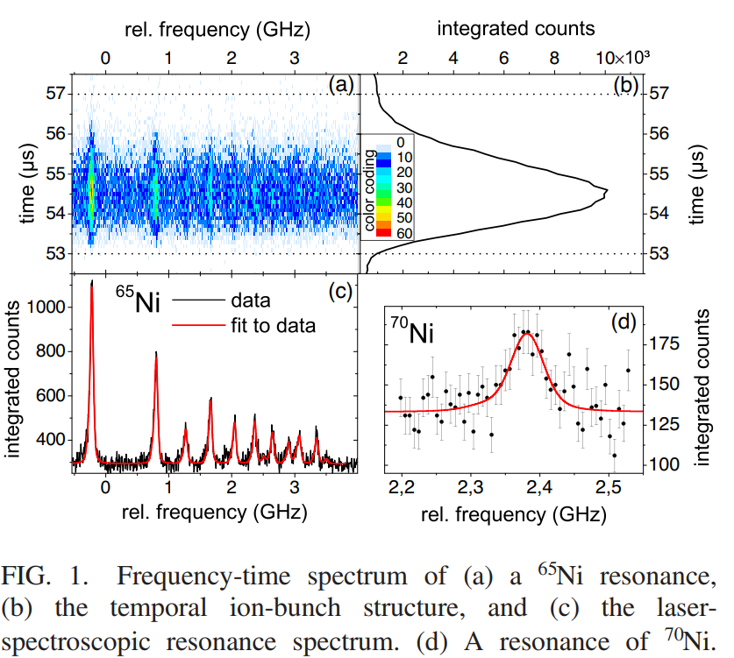
Experimental setup.
TILDA system and spectra (Fig. 1a–c):
2D plots show laser frequency (x) vs. time after RFQ extraction (y); color = photon counts per 100 ns bin.
Integrating over time yields the ion bunch profile; integrating over frequency within a chosen time window gives the isotope’s resonance spectrum.
Handling 70Ga contamination (Fig. 1d):
· Suppression strategy: keep ISOLDE beam gate closed for 2 s after proton impact so volatile 70Ga is released first, then accumulate 70Ni for 1.2 s in RFQ before extraction to COLLAPS, enabling a clean 70Ni resonance spectrum.

Slide 9
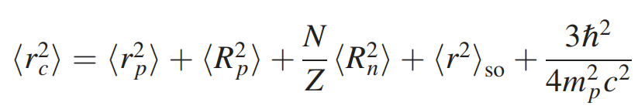
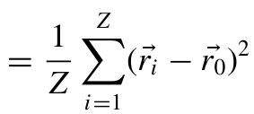
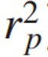
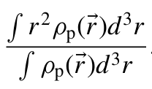
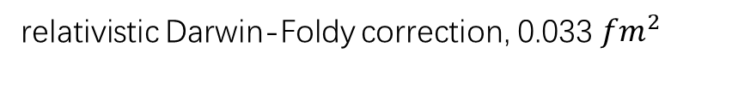

Nuclear charge radius
relativistic Darwin-Foldy correction, 0.033 ${fm}^{2}$
spin-orbit correction
where $<R_{p}^{2}>$and $<R_{n}^{2}>$are the mean-square charge radii of the proton and the neutron.
In this letter,$<R_{p}^{2}>$ =0.709${fm}^{2}$ and $<R_{n}^{2}>$ = -0.106${fm}^{2}$
The point-proton radius are defined as
The point-proton root-mean-square (rms) radius operator is a two-body operator, use the one-body local density to calculate the radius

Slide 10
3
Results and Analysis

Slide 11
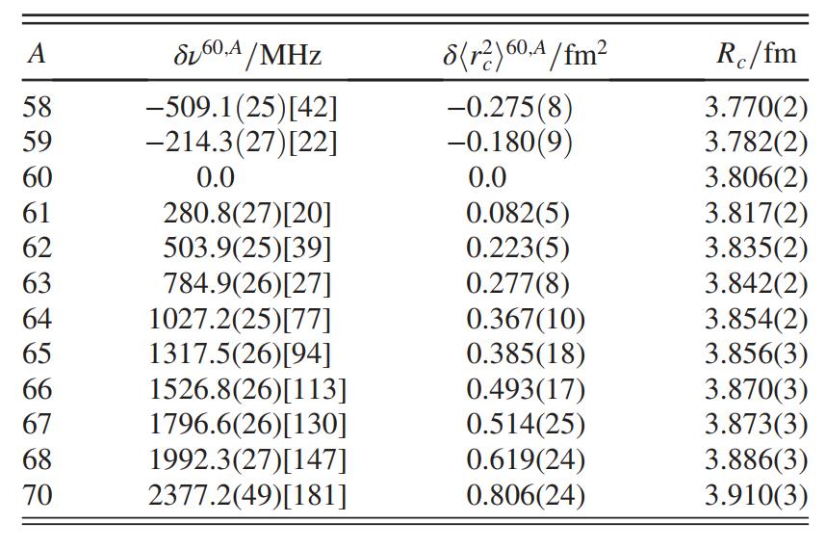
Experiment Analysis
Isotope shift determination and charge radii extraction:
· Isotope shifts δν₆₀,A = νA − ν₆₀ calculated relative to the center frequency of reference isotope 60Ni.
· Two beamtimes analyzed separately; small linear offsets corrected by adjusting main acceleration voltages within divider uncertainties (−3.5 V at 30 kV; +2.5 V at 40 kV).
· Remaining scatter between beamtimes treated by adding an extra statistical uncertainty so that χ²≈1.
· Mean-square charge-radius changes δ⟨r²⟩₆₀, a derived using field-shift factor F = −783(94) MHz/fm² and mass-shift factor M = 950(5) GHz u.
· Uncertainties of δ⟨r²⟩ dominated by correlated error from F.
Absolute radii Rc obtained from δ⟨r²⟩ using Rc(60Ni)=3.806(2) fm.

Slide 12
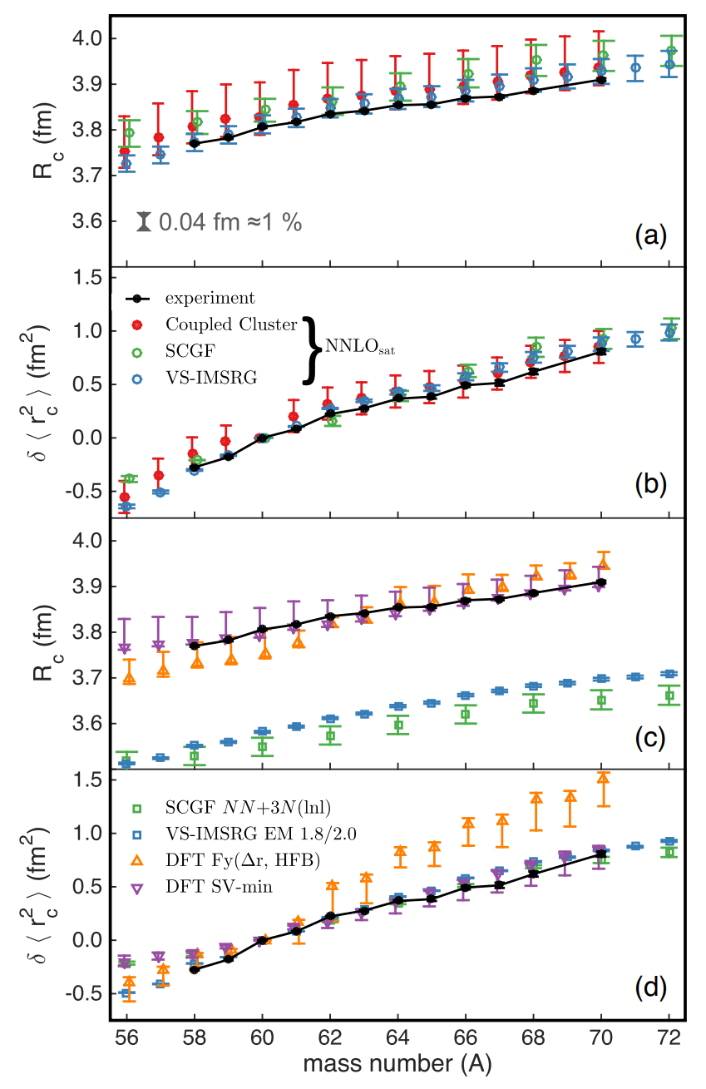
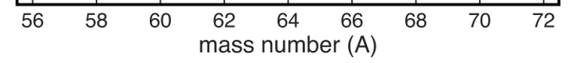
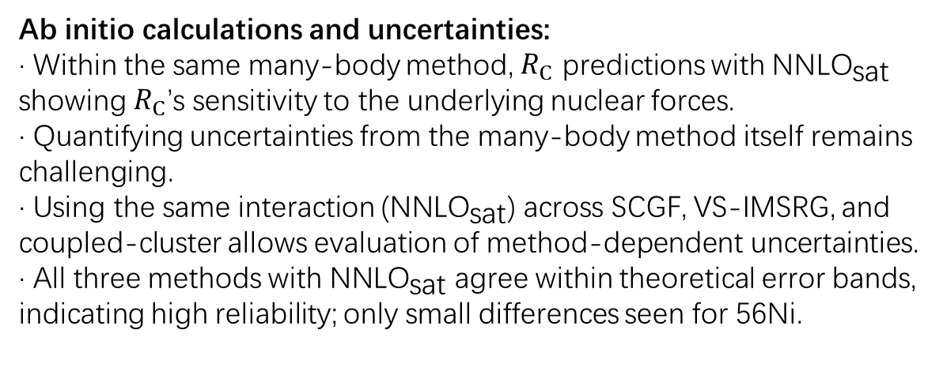
Theoretical calculation
Ab initio calculations and uncertainties:
· Within the same many-body method, $R_{C}$ predictions with ${\text{NNLO}}_{\text{sat}}$ showing $R_{C}$’s sensitivity to the underlying nuclear forces.
· Quantifying uncertainties from the many-body method itself remains challenging.
· Using the same interaction (${\text{NNLO}}_{\text{sat}}$) across SCGF, VS-IMSRG, and coupled-cluster allows evaluation of method-dependent uncertainties.
· All three methods with ${\text{NNLO}}_{\text{sat}}$ agree within theoretical error bands, indicating high reliability; only small differences seen for 56Ni.
We take the neutron p₃/₂, p₁/₂, f₅/₂, g₉/₂ valence space outside a ⁵⁶Ni core.

Slide 13
Theoretical calculation
DFT performance on Ni charge radii:
· The Fayans functional Fy(Δr; HFB) is usually successful in describing odd–even staggering and kinks at shell closures.
· Skyrme functionals such as SV-min generally fail to reproduce these features.
· Along the measured Ni isotopes, odd–even staggering and kinks are weak, and SV-min follows the experimental trend more closely than the Fayans functional.
· A potential deficiency of the current Fayans functional is the absence of an isovector component in its pairing term; future work will focus on including this isovector pairing contribution.

Slide 14
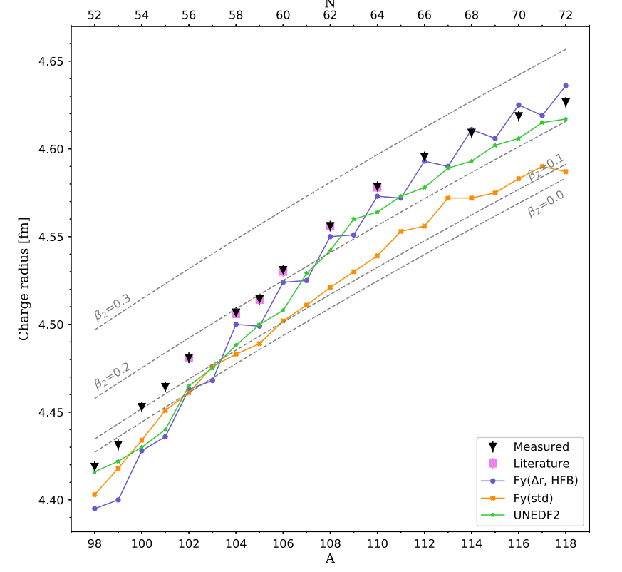
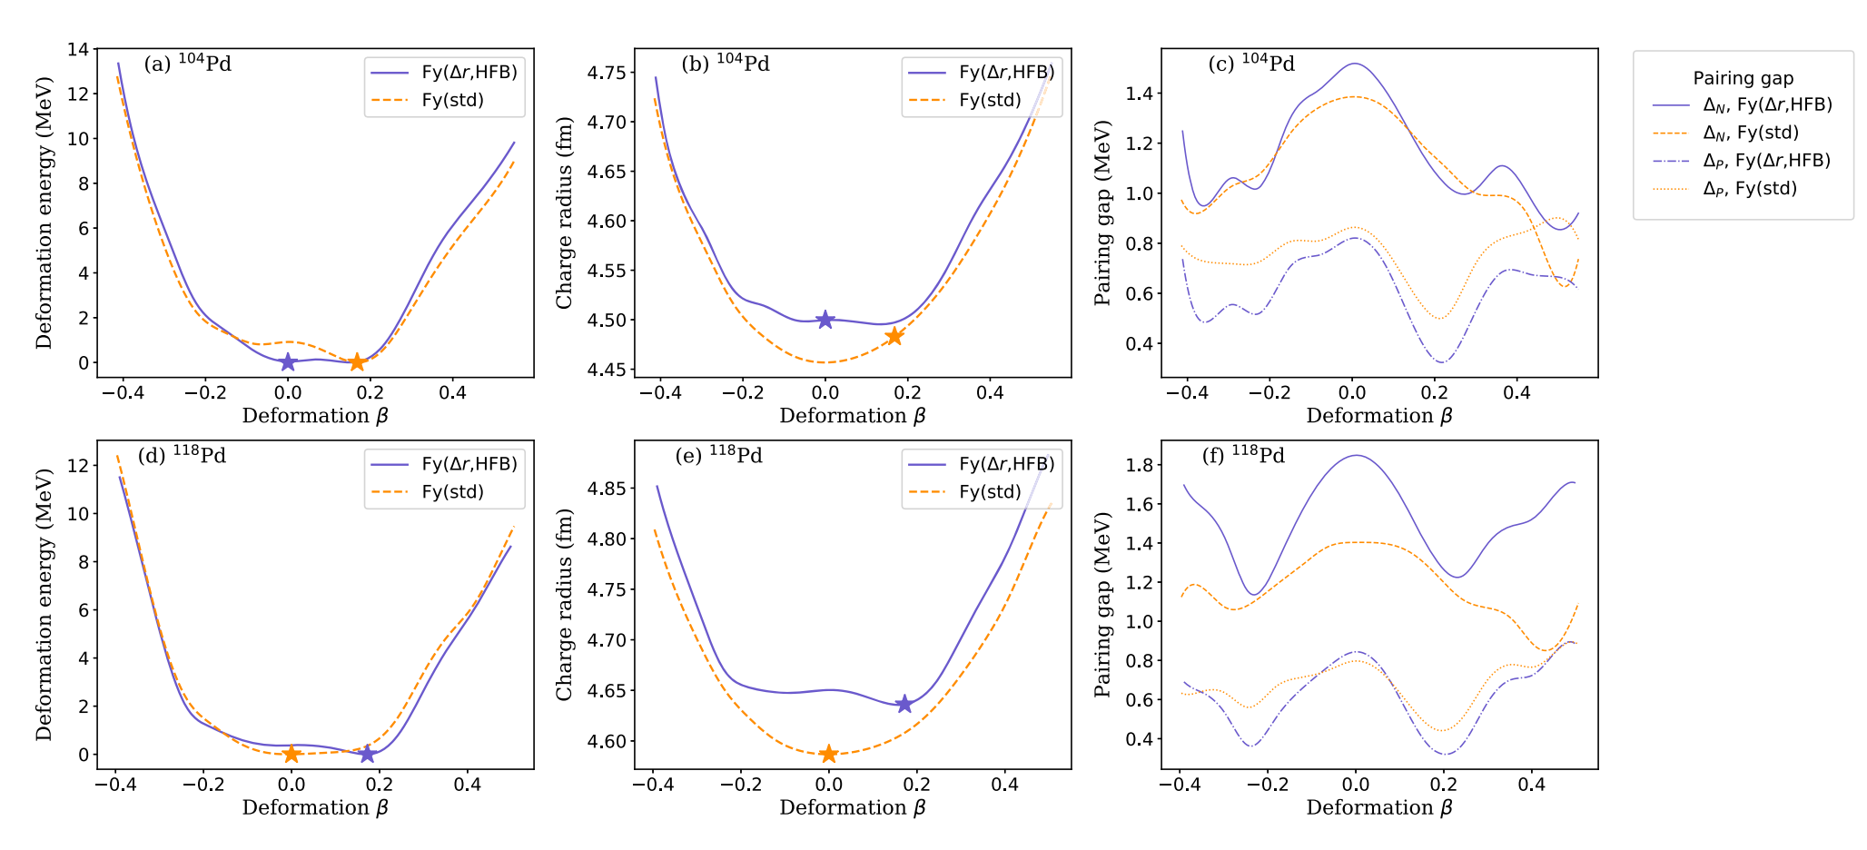
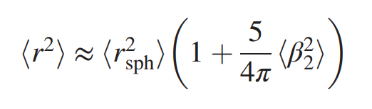
Other Experiment of nuclear charge radius (Palladium Isotopes )
PHYSICAL REVIEW LETTERS 128, 152501 (2022)
Impact of Nuclear Deformation and Pairing on the Charge Radii
Liquid droplet model
Fy(Δr HFB) is the only functional which reproduces the correct direction of the odd-even staggering (OES), In odd-N isotopes, the blocking of the odd particle orbital leads to a reduced strength of the pairing correlations, and, hence, to smaller radii

Slide 15
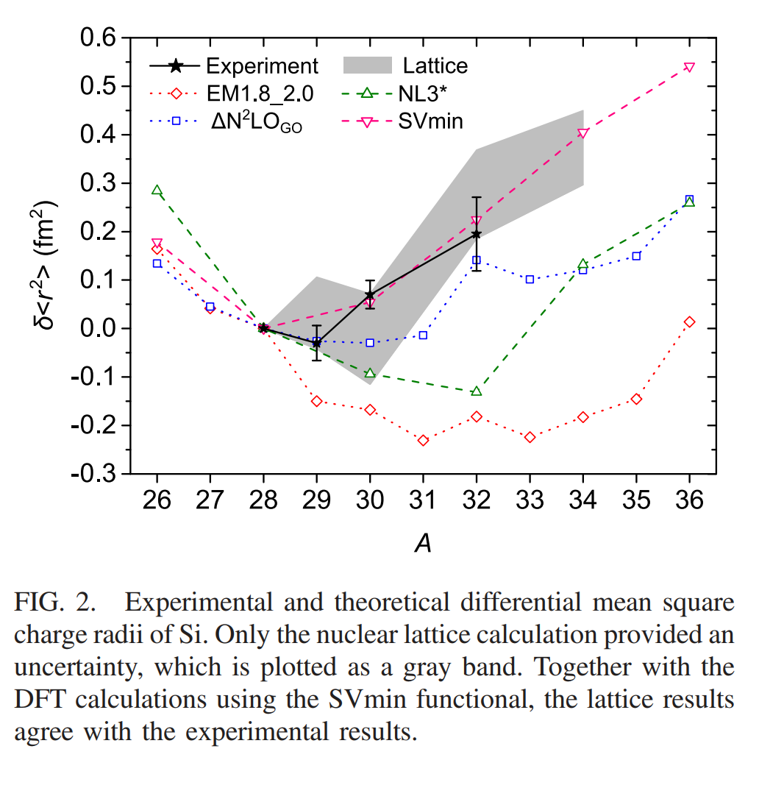
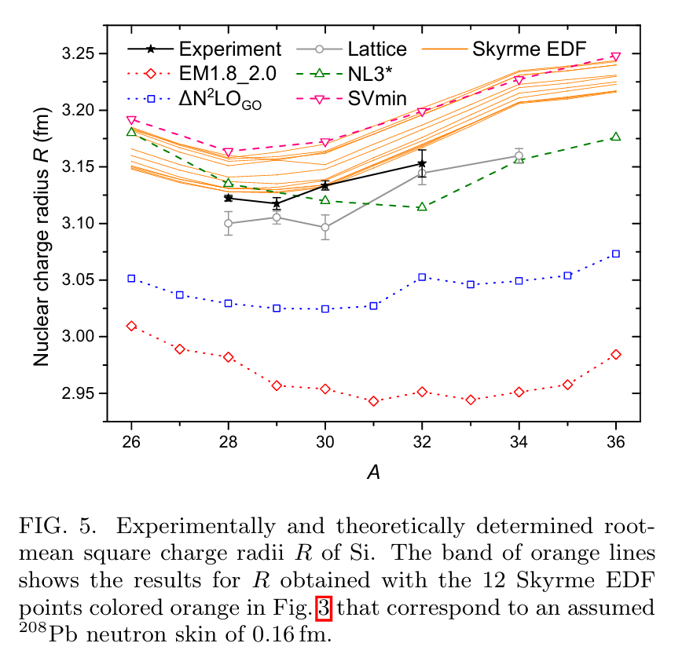
Other Experiment of nuclear charge radius (Silicon Isotopes )
PHYSICAL REVIEW LETTERS 132, 162502 (2024)
The DFT calculation using the SVmin functional show a good agreement, while VS-IMSRG underpredicts absolute charge radii.

Slide 16
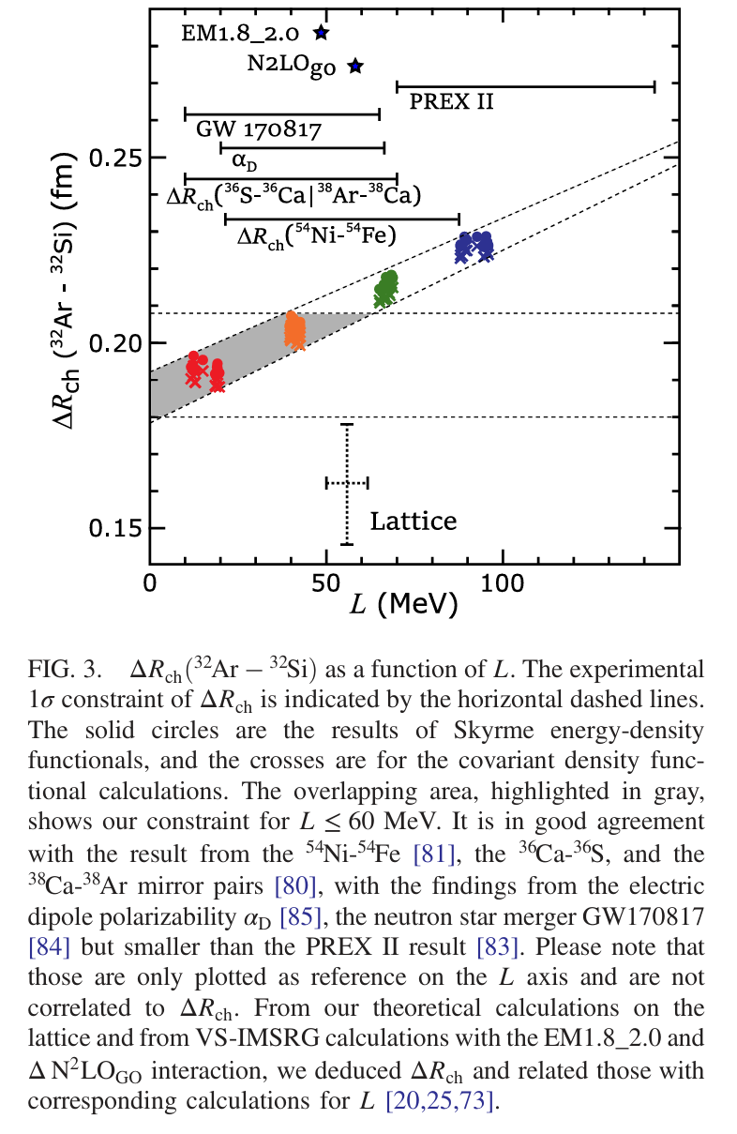
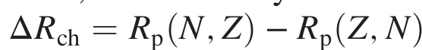
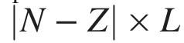
Other Experiment of nuclear charge radius (Silicon Isotopes )
Within the DFT framework, the sensitivity of the mirror charge radii difference
,to L, was found to be
correlated with
DFT calculations were performed for 48 Skyrme energy-density functionals.
The colors in the figure indicate the assumed values for the neutron skin of 208Pb: 0.12 fm (red), 0.16 fm (orange), 0.20 fm (green), and 0.24 fm (blue)
All of those theoretical results agree with our experimental constraint of L ≤ 60 MeV

Slide 17
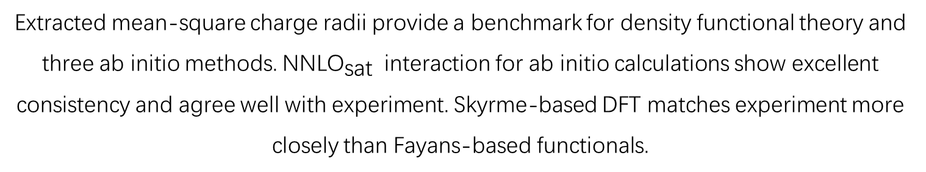
Summary of the Study
Collinear laser spectroscopy of short-lived nickel isotopes 58–68 and 70Ni was performed.
Extracted mean-square charge radii provide a benchmark for density functional theory and three ab initio methods. ${\text{NNLO}}_{\text{sat}}$ interaction for ab initio calculations show excellent consistency and agree well with experiment. Skyrme-based DFT matches experiment more closely than Fayans-based functionals.
This combined experimental and theoretical study establishes an accuracy of about 1% for nuclear charge radii in the Ni region.

Slide 18
Thanks for your attention
汇报人
时 间

